Slide 1
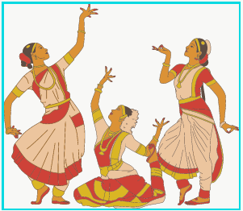
Mudra Recognition (deep learning project)
Pailla Rohit Reddy
Amrita Vishwa Vidyapeetham
Coimbatore

Slide 2
Content
1. Problem Defination
2. CNN
Custom made dataset
why CNN
3. Implementation
deployment of model via Google Colab

Slide 3
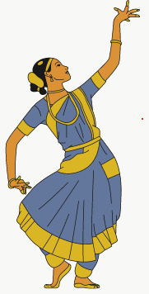
Information A distinctive feature of Bharatanatyam Dance is the use of expressive hand gestures. Hastas refers to a variety of hand symbols that a dancer can use. They can be classified as Asamyukta Hastas (Single hand gestures) and Samyukta Hastas (Double hand gestures). There exist 28 Asamyukta Hastas and 24 Samyukta Hastas.
PROBLEM DEFINITION :
Recognition of single hand gestures used by a Bharatanatyam dancer.

Slide 4
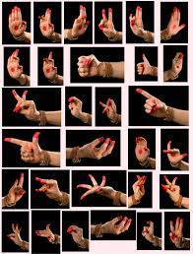
Custome made dataset
Collected various hand signature of 28 types in Bharata Natyam and separated them into 28 folders

Slide 5
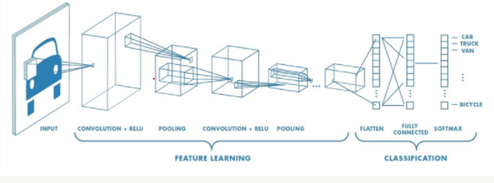
CONVOLUTIONAL NEURAL NETWORK (CNN) CNN is a Deep Learning algorithm that can take in an input image, assign importance (learnable weights and biases) to various aspects/objects in the image and be able to differentiate one from the other. The pre-processing required in a CNN is much lower as compared to other classification algorithms The advancements in Computer Vision with Deep Learning has been constructed and perfected which leads to a Present Mudra Recognition

Slide 6
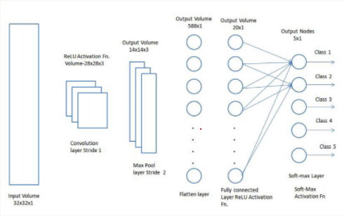
The role of the CNN is to reduce the images into a form that is easier to process, without losing features that are critical for getting a good prediction
STEPS INVOLVED:
Input layer
Convolution
pooling
Flattening
Activation function
Output Layer
There are various architectures of CNNs available which have been key in building algorithms that powers Al

Slide 7
